Slide 1

M.V.P SAMAJ’S K.T.H.M.COLLEGE, NASHIK
“Performance Analysis of Mutual Funds Using ANOVA and Risk-Return Measures”
SUBMITTED BY
Ekta Kapadnis , Omkar Dhepale , Chetana Sonavane, Devendra Ahire, Vaibhav Aher
Department of Statistics
Under the Guidance of
Dr. Kalpesh Amrutkar

Slide 2

“Performance Analysis of Mutual Funds Using ANOVA and Risk-Return Measures”
A comprehensive statistical study evaluating the performance and risk characteristics of selected Large
cap mutual funds from leading Indian Asset
Management Companies including SBI, UTI, Nippon, Mirae Asset, and HDFC.

Slide 3
Objectives:
To analyze the performance of selected Large-cap mutual funds from SBI, UTI, Nippon, Mirae Asset, and HDFC.
To compare the returns (NAV returns) of the selected mutual funds over a specified time period.
To examine the consistency and variability in returns among the selected mutual funds.
To evaluate which mutual fund performs better based on statistical analysis.
To understand the effectiveness of investment strategies adopted by different Asset Management Companies.
To provide insights for investors in selecting suitable Large-cap mutual funds based on performance comparison

Slide 4
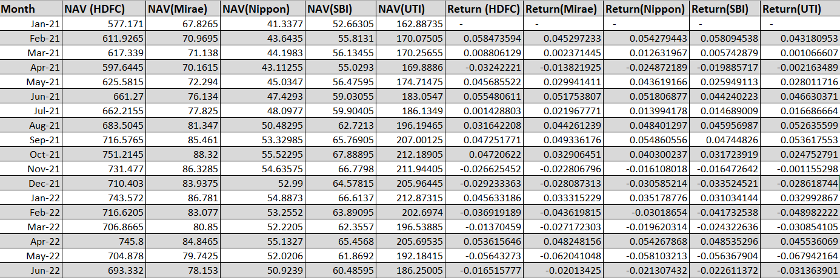
Data :
The data shows the Net Asset Value (NAV) and Monthly returns of five mutual funds: HDFC, Mirae, Nippon, SBI, and UTI
over different time periods.
NAV values indicate the market value of each fund, while returns show the percentage gain or loss from one period to the next.
The data reveals that fund performance fluctuates over time, with both positive and negative returns, indicating
changing market conditions.

Slide 5
Methodology :
Five mutual funds were selected from major AMCs including SBI, UTI, Nippon, Mirae Asset, and HDFC. Selection criteria included fund popularity, historical performance track record, and market presence. The sampling framework ensures representation from leading players in the mutual fund industry.
1.Data Collection:
Secondary data from AMFI and financial platforms for 5 mutual funds over 5 years (2021-2025)
2.Descriptive:
Calculate mean, variance, standard deviation, minimum, and maximum returns
Independent Variable
3.Regression:
Mutual Funds: SBI, UTI, Nippon, Mirae Asset, HDFC representing different investment strategies and portfolio management styles
Estimate Alpha and Beta to measure fund performance and market sensitivity
4.ANOVA Testing:
Dependent Variable
Compare mean High vs. Low values to identify significant performance differences
Returns/NAV Returns: Performance metrics used to evaluate and compare fund returns over time

Slide 6
Performance Comparison:
Mutual funds | Average Return
HDFC Fund | 1.34% (Strong performance)
SBI Fund | 1.19% (Stable returns)
Nippon Fund | 1.58% (Highest average)
Mirae Assets | 1.14% (Consistent growth)
UTI Fund | 1.09% (low average)
HDFC Fund: HDFC Fund shows strong performance with a relatively high average return compared to other funds.
SBI Fund: SBI Fund provides stable and consistent returns, indicating balanced performance.
Nippon Fund: Nippon Fund achieved the highest average return, making it the best-performing fund in the group.
Mirae Assets: Mirae Assets demonstrates steady growth with consistent but moderate returns.
UTI Fund: UTI Fund has the lowest average return, indicating comparatively weaker performance among the funds.

Slide 7
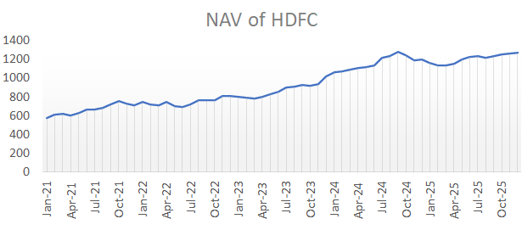
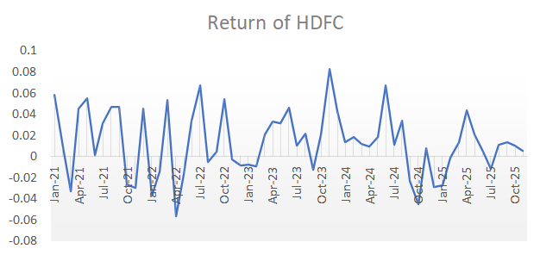
Performance of NAV and Returns (2021–2025)
NAV of HDFC: The NAV of HDFC shows an overall upward trend from 2021 to 2025, indicating steady growth in the fund’s value despite minor fluctuations.
Return of HDFC: The returns of HDFC fluctuate over time with both positive and negative values, showing variable performance but generally maintaining positive returns in most periods.
All the fund shows steady growth in NAV with fluctuating returns, indicating stable performance over the study period.

Slide 8


Alpha & Beta Comparison:
 | HDFC | SBI | Mirae | Nippon | UTI
Alpha (α) | 0.0078358 | 0.006447 | 0.005825 | 0.0100089 | 0.00554389
Beta (β) | 0.5022984 | 0.493105 | 0.50140 | 0.5219765 | 0.49802926
Alpha (α) -: Measures excess return generated by a fund compared to market benchmark
Beta (β) -: Measures sensitivity of fund to market movements (market risk)
Formula -:
Rp = Average fund return
Rm = Average market return
β = Beta value
Rp= Fund return
Rm= Market return
Cov = Covariance
Var = Variance
Nippon Mutual Fund achieved the highest alpha (0.0100), indicating superior performance and effective fund management.
All funds have beta values close to 0.5, meaning they are less volatile than the market and carry moderate risk.
SBI has the lowest beta (0.493), suggesting relatively lower risk compared to others.

Slide 9
ANOVA -:
The ANOVA (Analysis of Variance) test was conducted for each mutual fund to determine whether there is a significant difference between high and low NAV values. The states, while the states
Null hypothesis (H₀) : mean high equals mean low
V/S
alternative hypothesis (H₁) : they are different.
Source of Variation | Sum of Squ. | df | F | P-value
C(group) | 6.5544509 | 1 | 1.253748 | 0.265112
Residual | 6.16961 | 118 | NA | NA
CONCULSION: We Fail to reject H₀.
Since the p-value (0.2651) is greater than 0.05, there is no significant difference between the mean High and Low values. Therefore, both groups High and low values have similar average values.

Slide 10
Conclusion:
The analysis of selected mutual funds over the period 2021–2025 reveals a stable and consistent performance across all funds.
The findings indicate that all funds generated positive mean returns ranging approximately from 1.09% to 1.58%, highlighting their profitability and potential for wealth creation.
Among the selected funds, Nippon Mutual Fund delivered the highest average return, while UTI showed the lowest but maintained stable performance, reflecting reliability.

Slide 11
Limitations:
The study is limited to only five mutual funds, which may not represent the entire market.
The time period (2021–2025) may not capture long-term economic cycles or extreme market conditions.
Analysis is based mainly on historical data, which may not predict future performance accurately.
External factors such as inflation, interest rates, and global events are not included in the model.
The Alpha–Beta model assumes a linear relationship with the market, which may not always hold true.
Data accuracy depends on the source, and any data inconsistency can affect results.

Slide 12
References:
Association of Mutual Funds in India – Official website for mutual fund data, NAV, and industry reports.
Website: https://www.amfiindia.com
Securities and Exchange Board of India – Guidelines, regulations, and investor awareness resources.
Website: https://www.sebi.gov.in
National Stock Exchange of India – Market index data used for Beta calculation.
Website: https://www.nseindia.com
Bombay Stock Exchange – Historical market data and benchmark indices.
Website: https://www.bseindia.com
HDFC Mutual Fund – https://www.hdfcfund.com
SBI Mutual Fund – https://www.sbimf.com
UTI Mutual Fund – https://www.utimf.com
Nippon India Mutual Fund – https://mf.nipponindiaim.com
Mirae Asset Mutual Fund – https://www.miraeassetmf.co.in

